Slide 1
LaptopUps
Lap Ho Cheung
Gary Tang
Weng Lam Sio
University of Hawaii at Manoa
ICS 321 Fall 2014
Notes:
WL

Slide 2
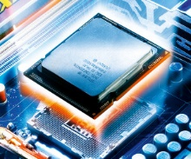
Background
Provide CPU upgrades for Lenovo laptops manufactured in 2006 to 2008
Database stores information about laptops and CPU
Retrieve available CPU upgrades
based on laptop model
Notes:
WL
Tell us about the application scenario
How DBMS can help
Basically setup the “problem” that your project addresses

Slide 3
Today's Topics
Overview of Application
Different Implementations
Performance Testing
Conclusion
Demo
Notes:
WL

Slide 4
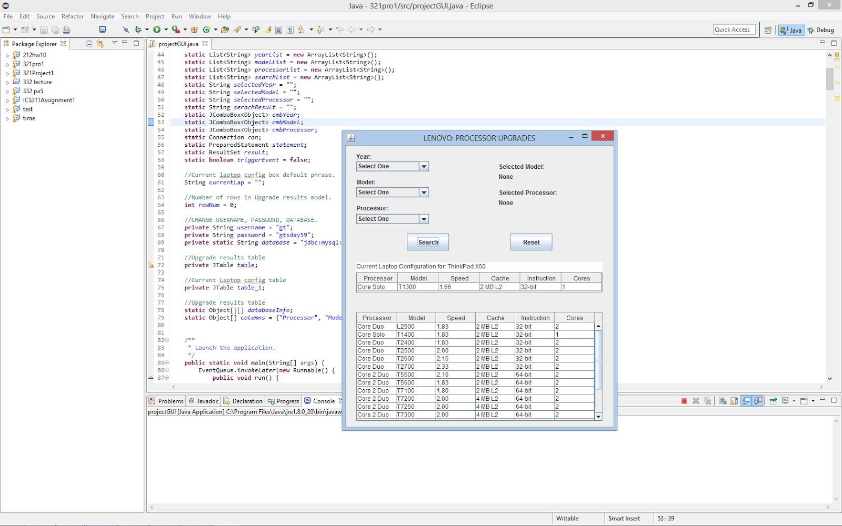

Overview of Application
User select year, model, current CPU of laptop
Display available CPU upgrades
for laptop
Notes:
WL
Tell us about how your team use DBMS in the application scenario described previously
Could use a diagram to illustrate your solution
What are some of the cool features

Slide 5
Database Server
Alienware M9750
2006
Windows 8.1
Apache 2.4.10
Intel Core 2 Duo 2.00 GHz
2 GB RAM
7200 RPM 120 GB
Internet Connection
Oceanic Cable
12 Mbps Down / 1 Mbps Up
Notes:
WL
Here is our modest server

Slide 6
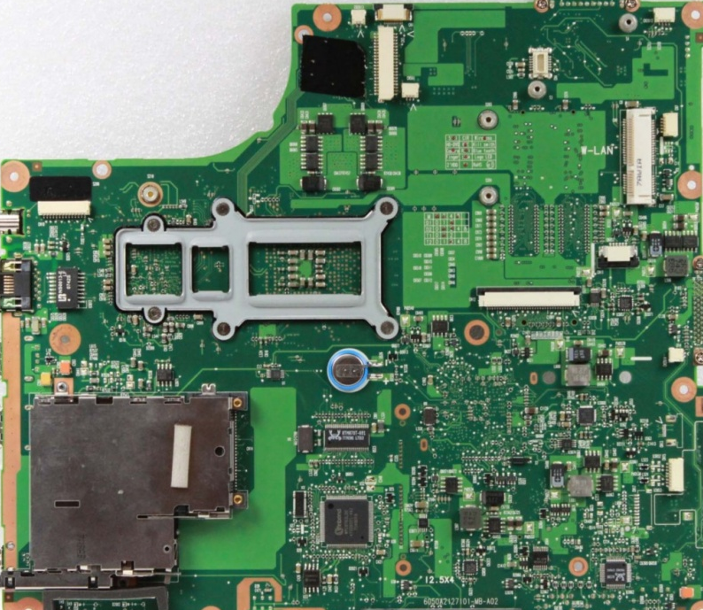
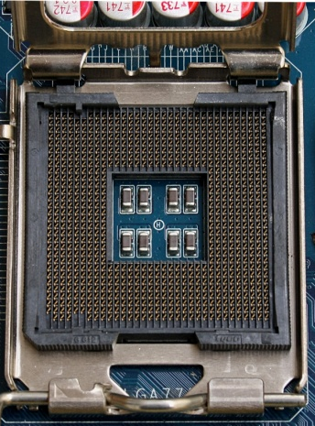
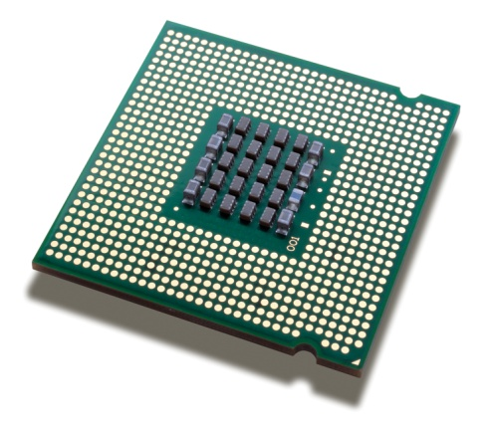
Gathering Data
+
=
Notes:
WL
1. Determine laptop motherboard socket and chipset.
2. Retrieve processor data from Intel's database.
Socket+motherboard=CPU

Slide 7
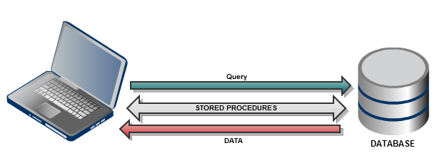
Design Alternatives
Java
Visual C#
Stored Procedures
Notes:
Gary
Java and C# similiarities
1. Object-Oriented Languages
2. All objects are references
3. Garbage Collection
4. Built-in Thread and Synchronization Support
Differences
1. JVM and CLR
2. C# has more functions
Stored Procedures
Most of the work done on server side. Less information sent between server and client.
old
Timestamp​
External link to Lenovo website

Slide 8
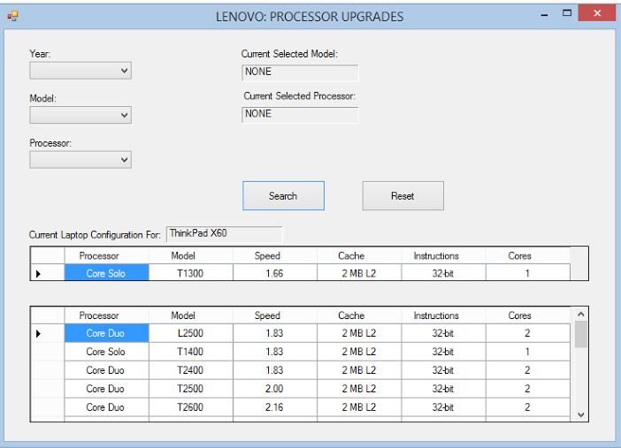
Java vs C#
Notes:
Gary
Same functionality on both implementations. Only slight appearance differences.

Slide 9
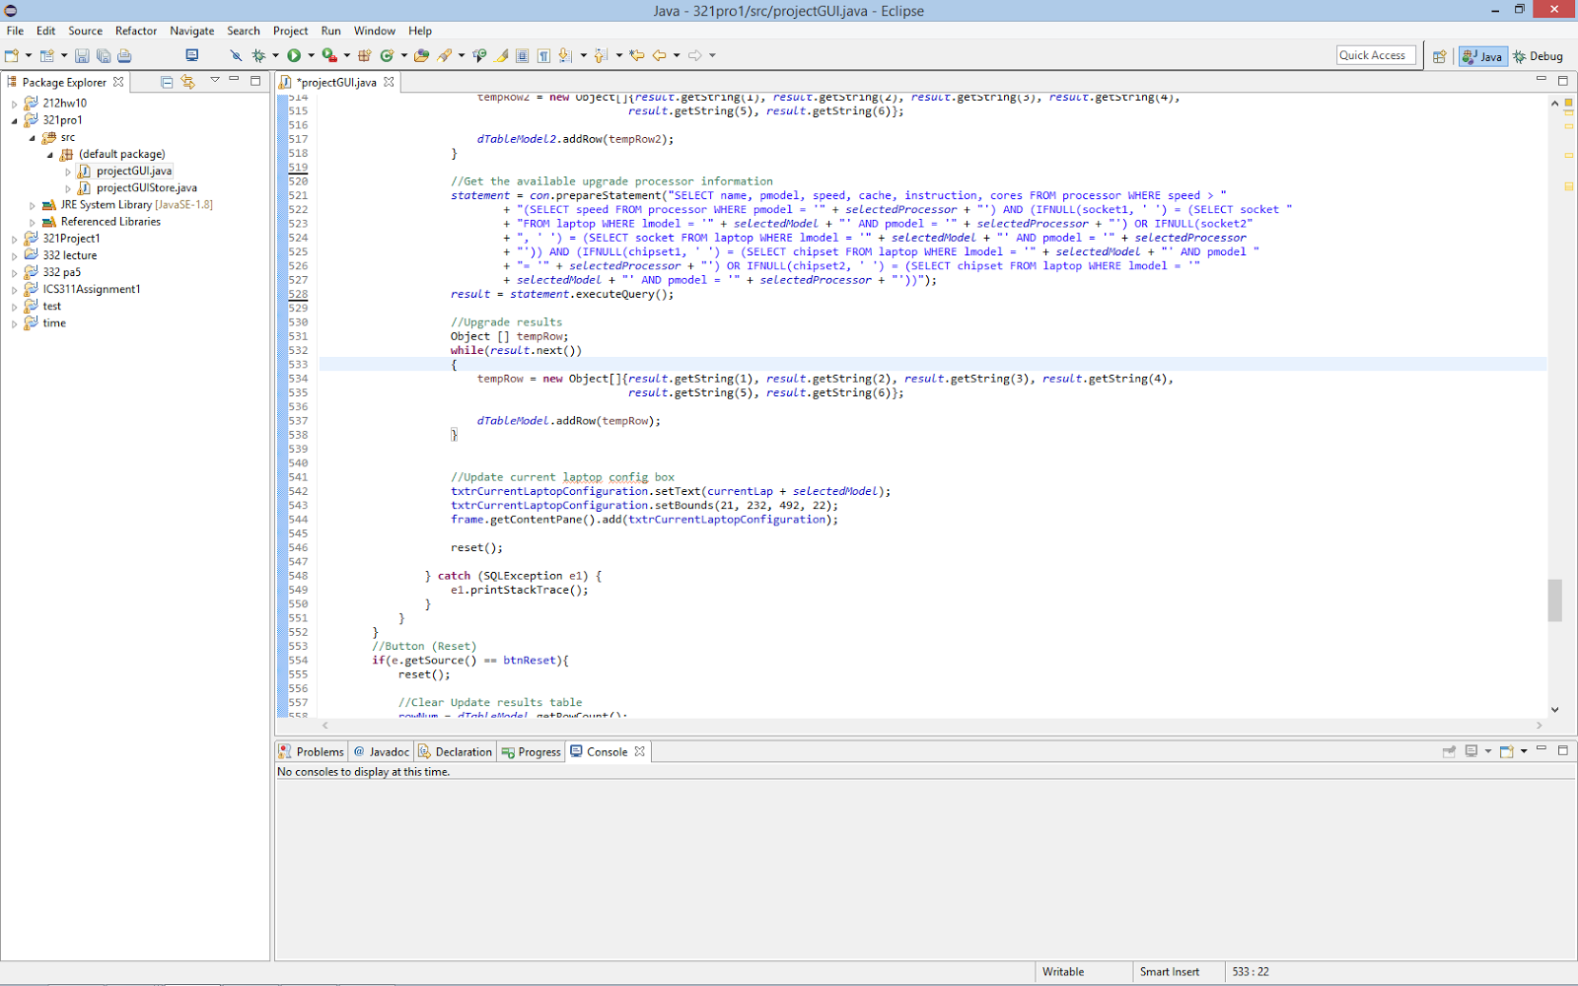
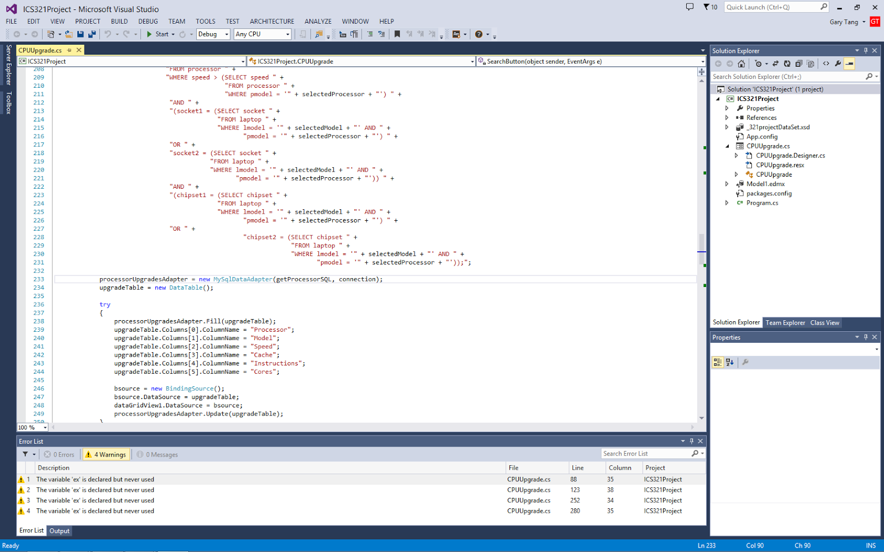
Java vs C#: Generating Results
z
Notes:
Gary
Retrieving results and populating application window.
Java uses while loop
C# does not

Slide 10
PERFORMANCE ANALYSIS
Intel VTune Amplifier XE 2015
End Time - Start Time
Query Time
Database Connection Time
6 Trials For Each Implementation
3 Consecutive Searches
Notes:
Gary
How did you evaluate the different alternatives ?
What data?
What metrics ?
What experiments ?
Used the Intel VTune Amplifier to profile our implementations.
Took difference between end and start time to determine query time and database connection time
Each implementation was tested 6 times
Tested wether consecutive searches had improved performance.
Old
Connection time​
Query time​
Localhost vs. Server​
Java without stored procedure vs. Java with stored procedure​
C# without stored procedure vs. C# with stored procedure​
Java without stored procedure vs. C# without stored procedure ​
Java with stored procedure vs. C# with stored procedure

Slide 11
PROGRAM EXECUTION TIME
Notes:
LapHo
Used Intel VTune Amplifier XE 2015 to measure time it took for program to complete one laptop search.
1. The C# implementation performed better than both Java implementations
and even the C# SP.
2. Java SP better than Java

Slide 12
CPU Utilization
Notes:
LapHo
Java Implementations used more CPU cycles.

Slide 13
Database Connection Time
Notes:
LapHo
On average, C# and C# w/ stored procedures had faster connection times.

Slide 14
Query Time
Notes:
LapHo
C# SP performs queries the most consistent.
And is slightly faster than the Java implementations.
Not much different making consecutive queries on one connection

Slide 15
Conclusion and Recommendations
C# implementation performed best
Store procedure
Retest
Larger database
Host database off island
Notes:
LapHo
Summarize
Make a conclusion and recommendation (re: alternatives) based on your experimental evaluation.

Slide 16
Demo
https://www.youtube.com/watch?v=CPUUwl7zhYI
Notes:
Don’t demo every feature
Pick just a couple of cool things to demo
0:20

Slide 17
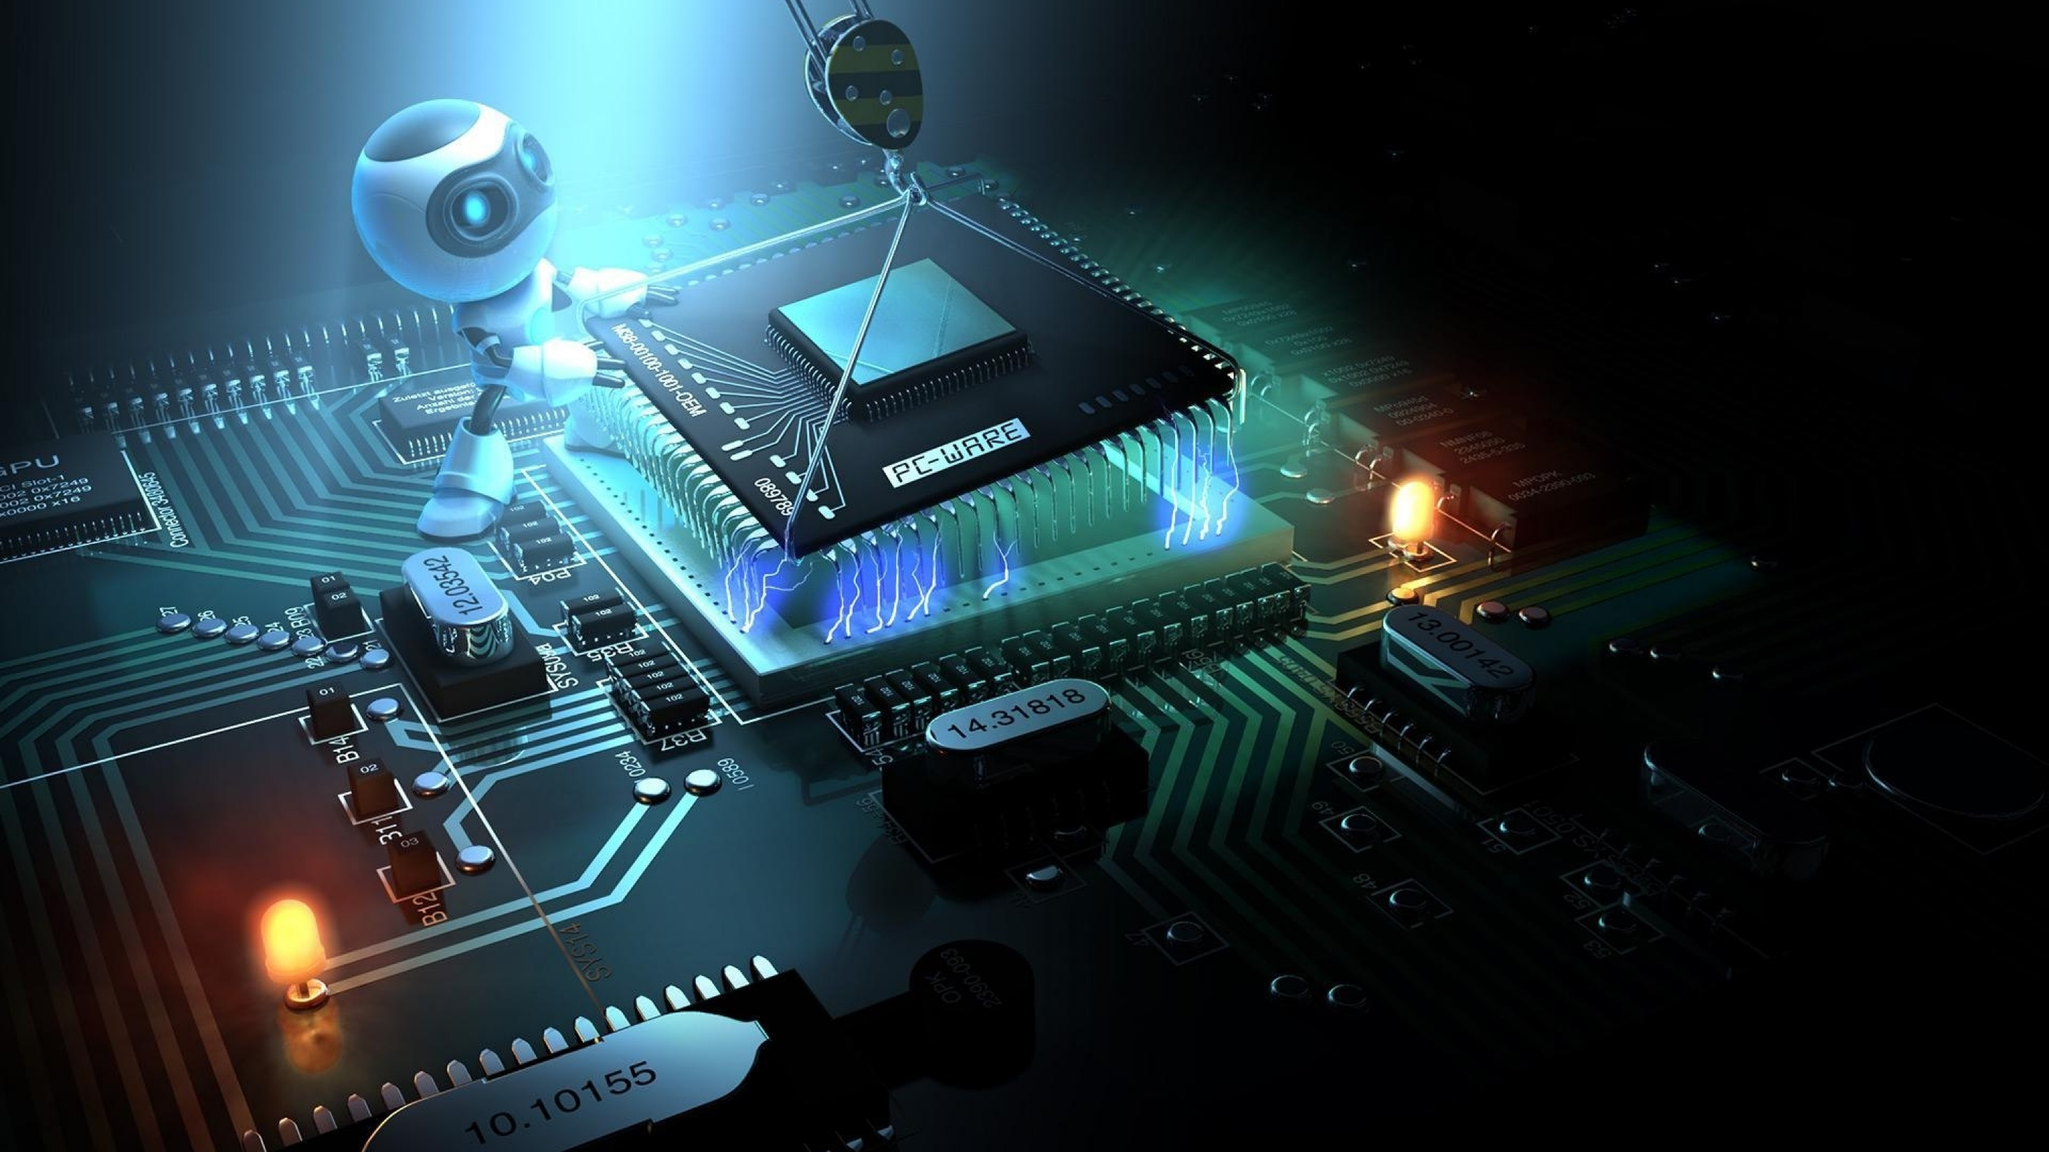
Question?

Slide 18
References
http://msdn.microsoft.com/en-us/library/ms836794.aspx#tchwhatssimilarbetweencjava
http://www1.cs.columbia.edu/~eaddy/publications/csharpvsjava-eaddy-ddj-feb01.pdf
http://dev.mysql.com/doc/refman/5.6/en/stored-routines.html
https://software.intel.com/en-us/intel-software-technical-documentation?field_software_product_tid%5B%5D=43703&field_operating_system_tid%5B%5D=20786
http://ark.intel.com/
http://support.lenovo.com/us/en/products?type=Laptops-and-netbooks&c=1

